Slide 1
Overview
Invitation
Accept
and review
Further communication
Manage personal details

Slide 2
Overview
Invitation
Accept and review
How to review
Download and review
Completion
Further communication
Update your information
Editorial workflow details
1 of 3
Technical check
Initial assessment
Peer review
Editorial office
quick check
Desk reject
Revise
Editorial Assistant
Editorial Office or EIC
Handling editor
Recommendation
Editor in Chief
Accept
Reviewers
Reject
Editorial Assistant
Ensures files are blind
Formatting
Completeness
Similarity report
Peer review files
Editorial Office
Assess scope and relevance
Ensure scientific quality
Checks originality and clarity
Ensure ethics and integrity
Sets up peer review stage
Assigns to Handling Editor
Invites reviewers
Handles reviewer reminders
Handling Editor
Evaluates submission
Recommends desk rejection
Invites reviewers
Evaluates comments
Makes recommendation
Handles revised manuscripts
Editor in Chief
Finalizes handling editor recommendations

Slide 3
Overview
Invitation
Accept and review
How to review
Download and review
Completion
Further communication
Update your information
TC and preliminary assessment
2 of 3
Technical check
Initial assessment
The Editorial office, in team with the Editorial Assistant, perform an thorough technical check based on the manuscript being
complete in all its parts
blinded for reviewers (if required by the Journal’s peer review policy)
not present potentially plagiarized contents
suitable for the journal and its sections
Authors’ solid background
If the submission is not deemed appropriate it will be rejected immediately.
Depending on the journal’s workflow, the submission will be assigned to the Editor in Chief or directly to a Handling Editor and the Editorial Office may start to search and invite suitable reviewers.
Desk reject
Editorial Assistant
Editorial Office or EIC
Editorial Assistant
Ensures files are blind
Formatting
Completeness
Similarity report
Peer review files
Editorial Office
Assess scope and relevance
Ensure scientific quality
Checks originality and clarity
Ensure ethics and integrity
Sets up peer review stage
Assigns to Handling Editor
Invites reviewers
Handles reviewer reminders

Slide 4
Overview
Invitation
Accept and review
How to review
Download and review
Completion
Further communication
Update your information
Peer review overview
3 of 3
Technical and similarity check,
Editor assignment
7 days
We have adopted a double anonymized peer-review process, which means that which means that reviewer identity is not made visible to author, author identity is not made visible to reviewer, reviewer and author identity are visible to Editor in Chief and Handling Editors
Reviewers are asked to supply confidential comments and recommendations, which will only be visible to the Section Editor and Editor in Chief, and comments for the authors which are shared in an anonymous way.
Reviewer reports are confidential and are not posted with the articles.
Peer review details:
Identity transparency: single anonymized
Reviewer interacts with: Editor in Chief, Section and Handling Editors
Review information published: none
Submission
Editorial evaluation
Peer review
Time to reply:
7 days
Reviewer invitation
TARGET
Submission to 1st decision
4-6 wks
Time to submit: 30 days
Recommendation

Slide 5
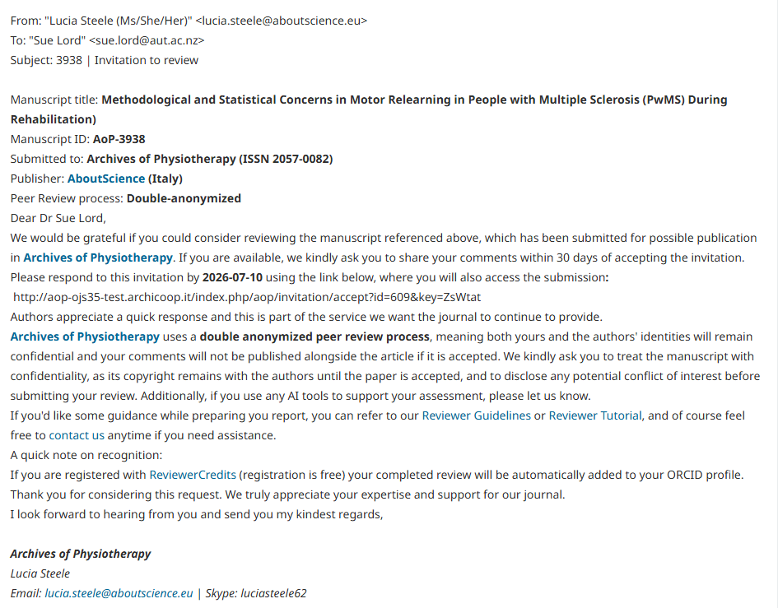
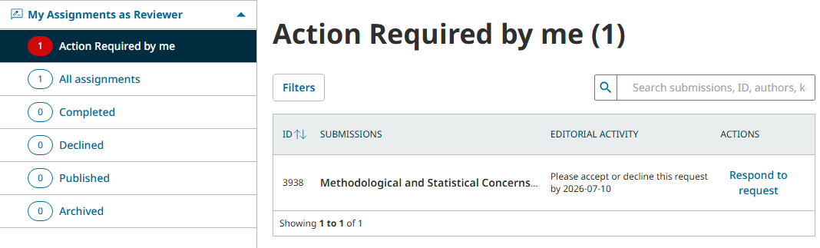
5
Accept and review
How to review
Download and review
Further communication
Update your information
Overview
Invitation
Completion
Invitation
When an Editor invite you to review a manuscript, you will receive an email in your inbox. This email may also land in your spam folder, so please check this as well.
The email will contain the abstract, a link to the submission and an indication of the associated deadlines: the editor may change the deadlines upon invitation.
To respond to an invitation, click on the link provided.
You may also access the submission invitation logging in with your username and password from the journal’s submission site.
Inviting Editor
Reviewer

Slide 6
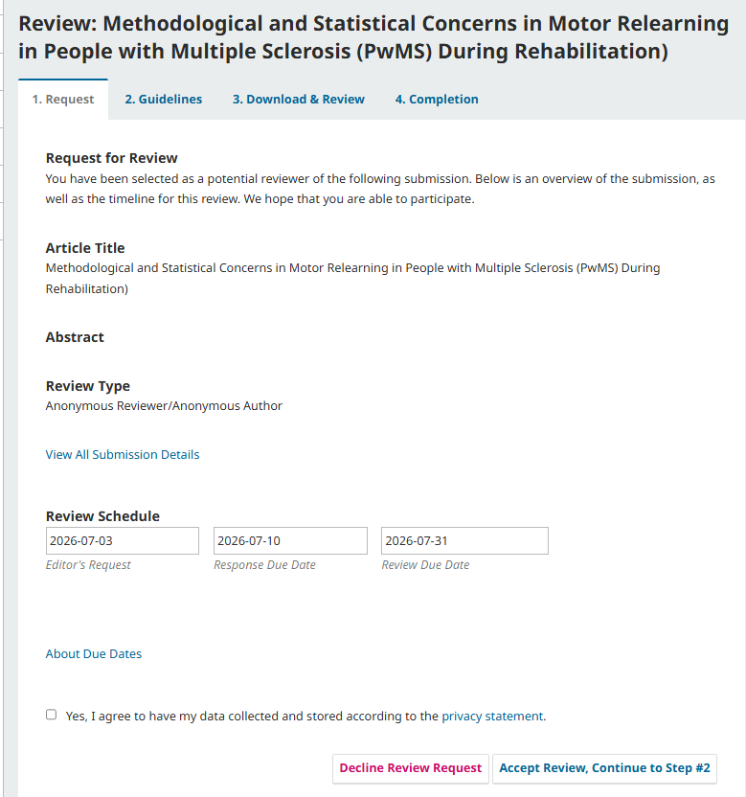
6
Accept and review
How to review
Download and review
Further communication
Update your information
Overview
Invitation
Completion
Accept and review
The Request tab will outline the revision’s relevant dates and will enable you to respond to the invitation.
You will need to agree to the privacy statement in order to proceed.
Click “Accept Review” to continue.
If you cannot accept the invitation, click on “Decline Review Request” where you will find space to communicate with the Editor and possibly suggest alternative reviewers.

Slide 7
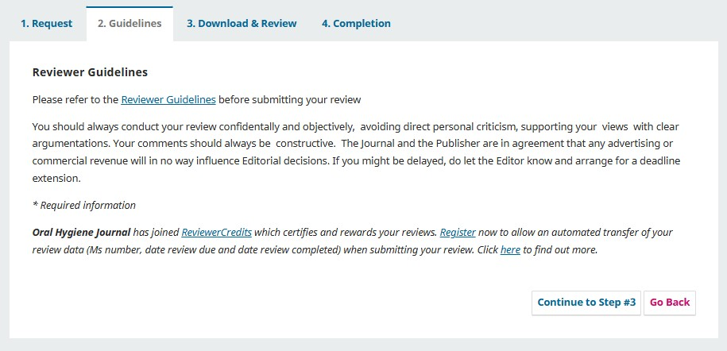
7
Accept and review
How to review
Download and review
Further communication
Update your information
Overview
Invitation
Completion
How to review
The Guidelines tab will present the journal’s guidelines.
Should you need additional information please contact us anytime:
Email: editorial@aboutscience.eu

Slide 8
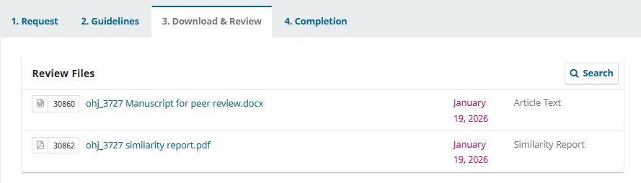
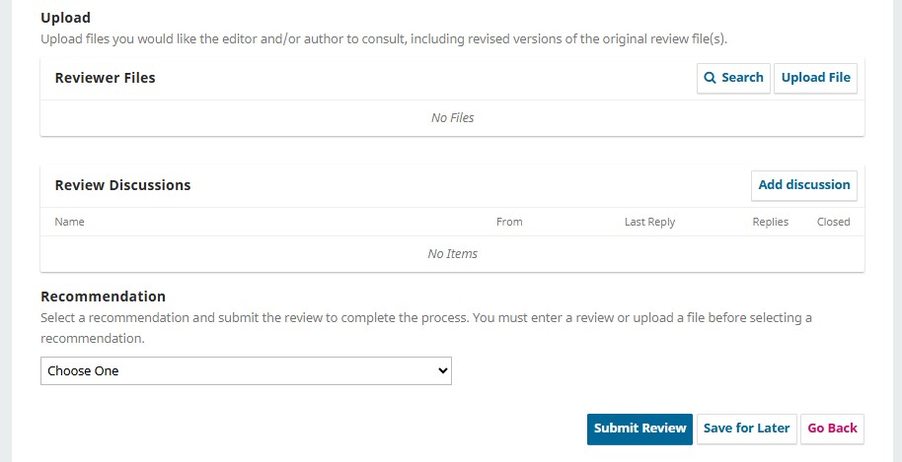
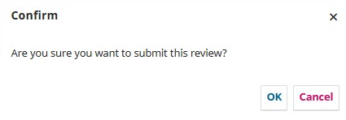
8
Accept and review
How to review
Download and review
Further communication
Update your information
Overview
Invitation
Completion
Download and review
The Download & Review tab will enable you to download all review files and will present the review form to use to submit your comments. You will find a manuscript for peer review file, a similarity report and additional files relevant to the peer review process.
The review form consists of
Rating card
Comments to Authors
Confidential comments to Editor
Space for optional review comments
Your recommendation
Enter comment to the authors and confidential comments for the Editor in the appropriate space provided. Comments for the authors will be included in the decision letter. You may like to upload a file for reviewers, although we recommend that you list your comments in the box provided.
You will be presented with a final confirmation before submitting your review to the journal. Once you have submitted your review, you can no longer make any changes.

Slide 9
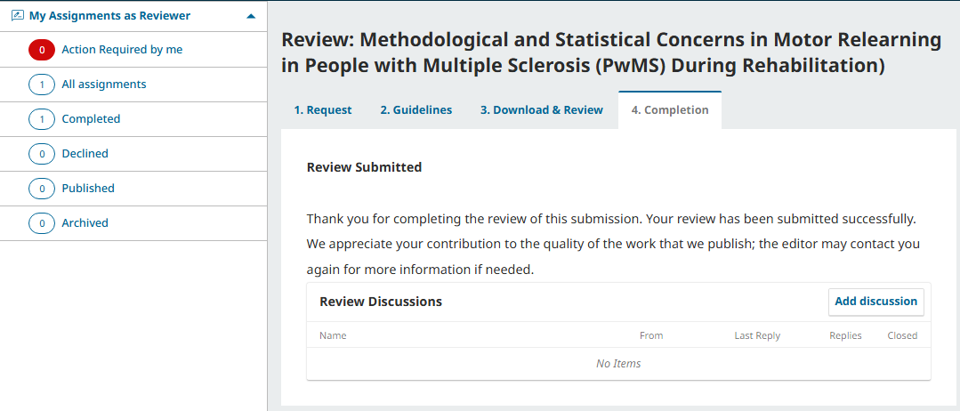
9
Accept and review
How to review
Download and review
Further communication
Update your information
Overview
Invitation
Completion
Completion
The tab Completion is a final confirmation screen you will be presented once you have submitted your review. At this point you can no longer make any changes to your comments.
You will find your completed assignment in the left hand side menu, where they will also be visible once the Editor has made a final decision.
Should you need to share additional information with the journal at this point, use the button “Add discussion”.

Slide 10
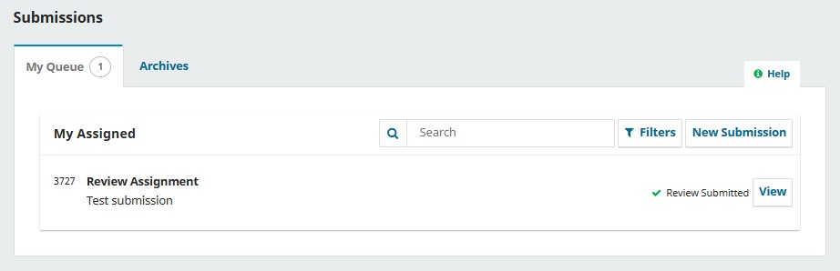
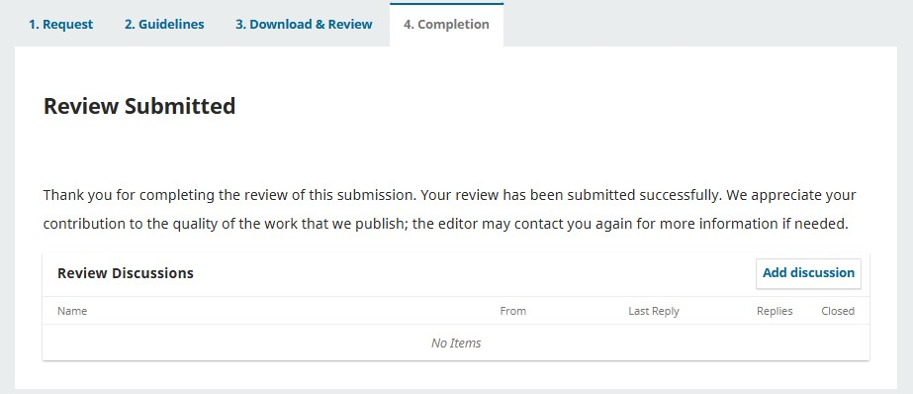
10
Accept and review
How to review
Download and review
Further communication
Update your information
Overview
Invitation
Completion
Further communication
In case you wish to contact the Editor with regards to the submission you have completed, you may access it from your main screen.
Identify the submission either in “My Queue” or in “Archives” and click on View.
You will then access your reviewer comments and the “Add discussion” button.
A submission will be in the “Archive” tab once a final decision has been made.

Slide 11
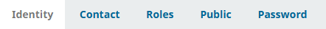
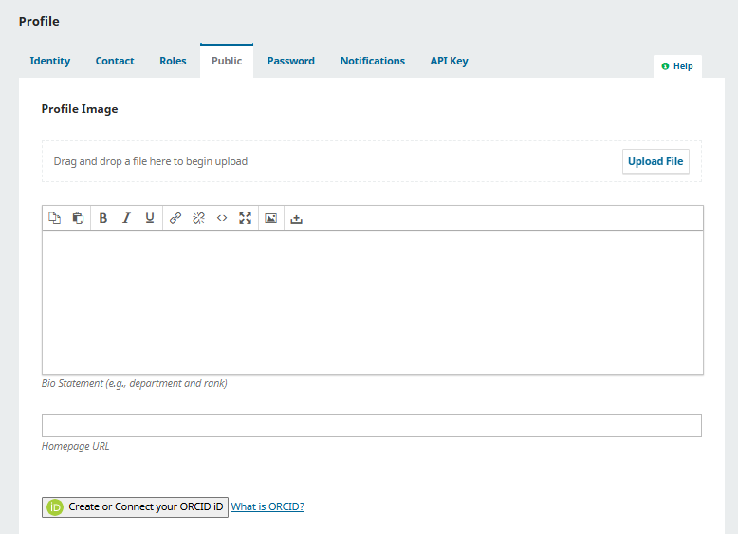
11
Accept and review
How to review
Download and review
Further communication
Update your information
Overview
Invitation
Completion
Manage your personal details
There is a wide set of information you may customize from the “Edit profile” area, in the top right of the screen. In order to receive invitations to review pertinent to your area of interest, we recommend that you complete your information in your profile. From the upper right corner choose “Edit profile”: choosing the different tabs, you can update your personal details, contact information, update your password and enter or complete your reviewing interests.
Identity allows you to choose how you wish your name to be visible in the system and add your ORCID.
Contact allows you to enter a signature, your affiliation and additional personal information;
In Roles you can enter your main specialty and your reviewing interests.
In the Public tab you may enter a profile image and a short biography;
When you are registered in the system you will receive a system password, which you may change anytime in the Password tab.
In the “Identity” tab, please enter your ORCID: this will ensure that your peer review activities is correctly recorded and connected where possible.
IMPORTANT!
Enter your reviewing interests. Please also enter your main
area of interest

